Slide 1
AUTOMATIC PUBLIC LIGHTNING SYSTEM
CSE7101- Capstone Project
Review-3
Batch Number:CSE_60
Under the Supervision of,
Mr. Tanveer Ahmed
Assistant Professor
School of Computer Science and Engineering
Presidency University
Roll Number | Student Name
20221CCS0005 20231CCS3005 20231CCS3006 | AMREEN J BHAVANA A AALIYA ZAINA
Name of the Program: Capstone Project
Name of the HoD: Dr. Anandaraj
Name of the Program Project Coordinator: Ms Priyanka Niranjan
Name of the School Project Coordinators: Dr. Sampath A K , Dr. Geetha A

Slide 2
Abstract
An energy-efficient automated public lighting system is proposed using ESP-NOW — a low-power, low-latency, peer-to-peer wireless protocol supported by ESP32 microcontrollers. The system uses distributed sensor nodes (Ambient light) mounted on street poles to detect time and ambient luminance. Nodes communicate locally using ESP-NOW to coordinate switching and dimming of lights, while a gateway node aggregates status and relays logs to a cloud server over Wi-Fi for monitoring and analytics. The design reduces energy consumption by dimming lights during low-activity periods and turning them to full brightness on demand, improves response time compared to cloud-dependent systems, and keeps costs low by using off-the-shelf ESP32 hardware.

Slide 3
Objectives
Design a low-cost, low-latency public lighting control system using ESP32 devices and ESP-NOW.
Implement local, autonomous decision-making at each pole (ambient light based).
Achieve at least 50% energy savings relative to always-on lighting through dimming and on-demand brightening.
Enable a gateway for remote monitoring, logging, and OTA updates.
Ensure reliability and safety (fail-safe: lights default to safe brightness on communication failure).
Demonstrate scalability across multiple poles with robust inter-node coordination.

Slide 4
Challenges
Accurate synchronization of RTC with the microcontroller
Relay circuit integration with high-voltage streetlight wiring
Handling power fluctuations during operation
Ensuring weatherproofing and protection from dust/moisture
Maintaining long-term reliability in outdoor conditions
Multiple trials needed for correct time calibration and scheduling

Slide 5
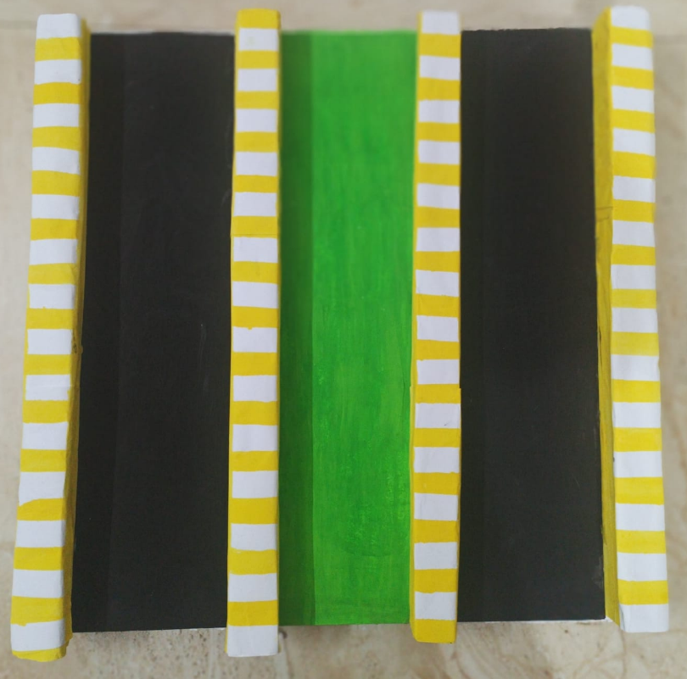
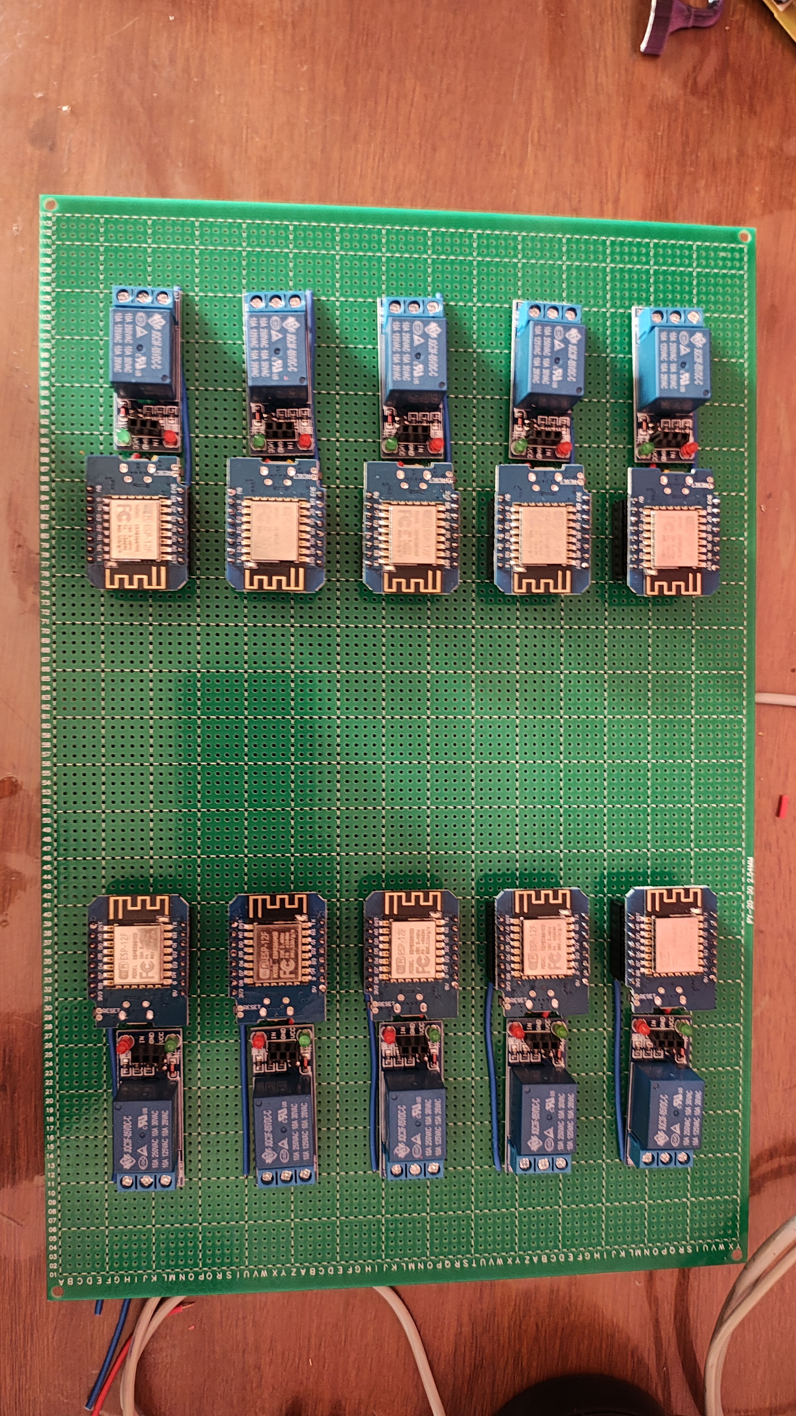
Project Progression

Slide 6
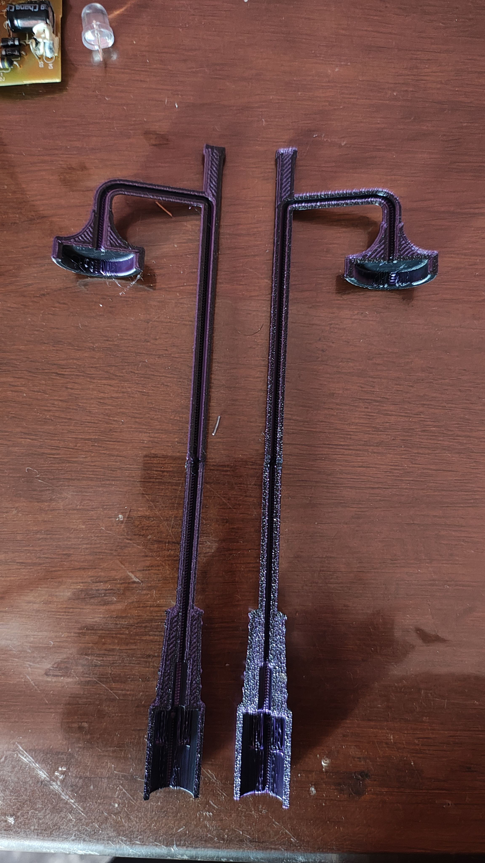
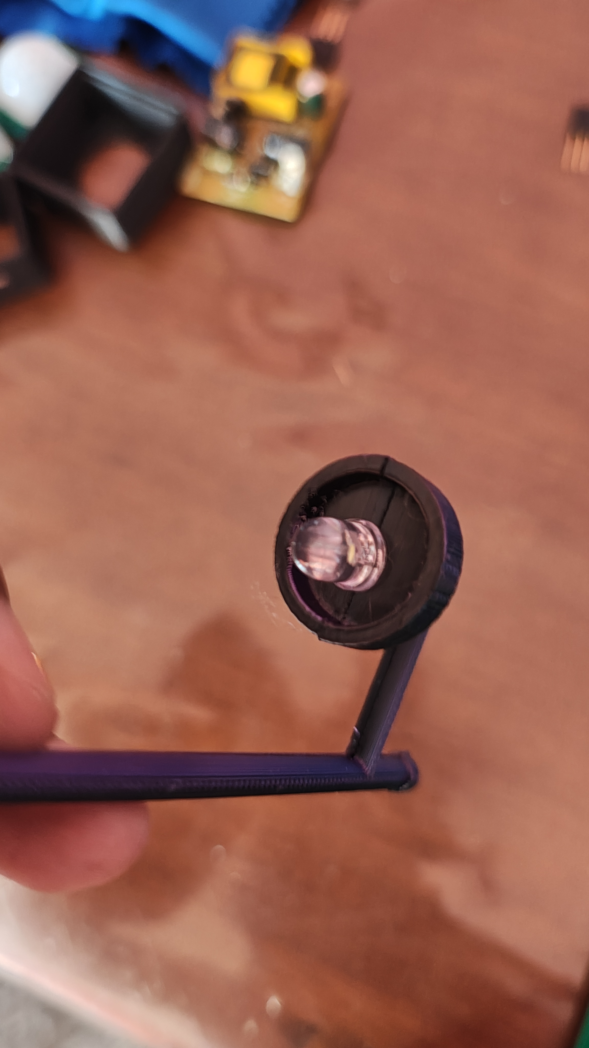
Project Progression

Slide 7
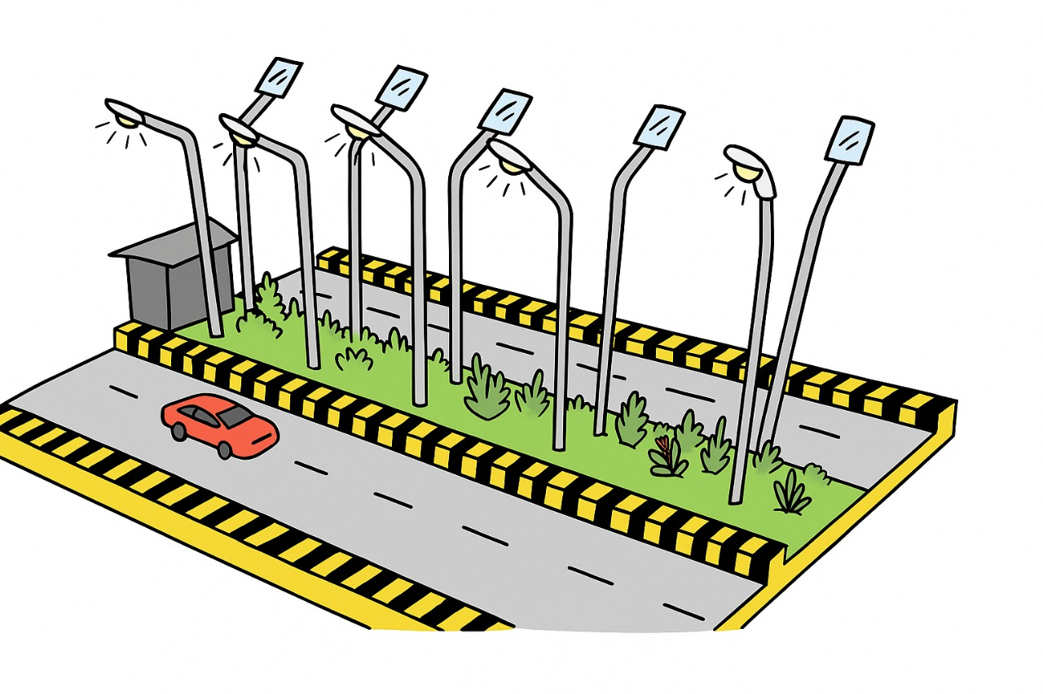
Proposed Model

Slide 8
Hardware & Software Requirements
Software Requirements
IDE: Arduino IDE
Libraries: ESP8266WiFi, ESP-NOW.
Protocol: ESP-NOW (for peer-to-peer communication)
Hardware Requirements
Item Specification
Microcontrollers ESP8266 (D1mini) ×6 units
Sensors Ambient Light Sensor ×1
Actuators 5V Single-Channel Relay Modules ×6
Lights LEDs (for simulation)
Power 5V Power Supply

Slide 9
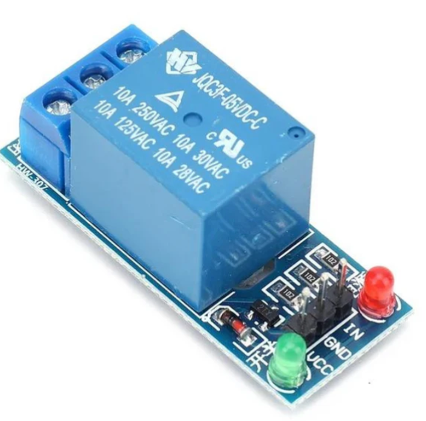
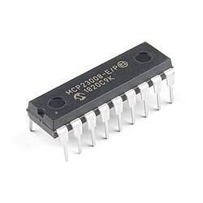
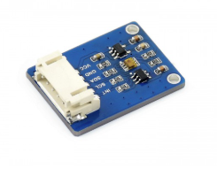
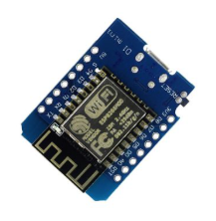
Components
5V Active Low Relay I2C [Inter-Integrated circuit] Ambient Light Sensor D1mini NodeMcu

Slide 10
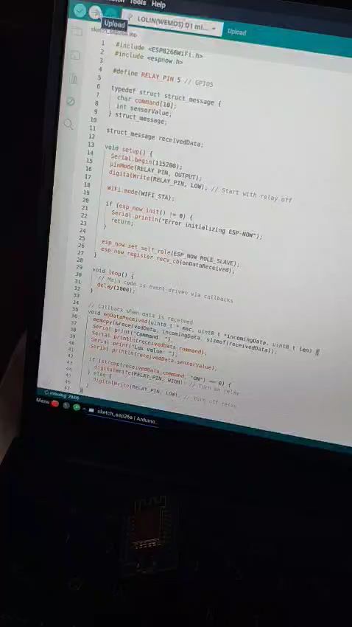
Proposed Model Video
Microcontroller Programming

Slide 11
GitHub Link
https://github.com/Amreen-552/Automated-Public-Lighting-System-Capstone-2025-

Slide 12
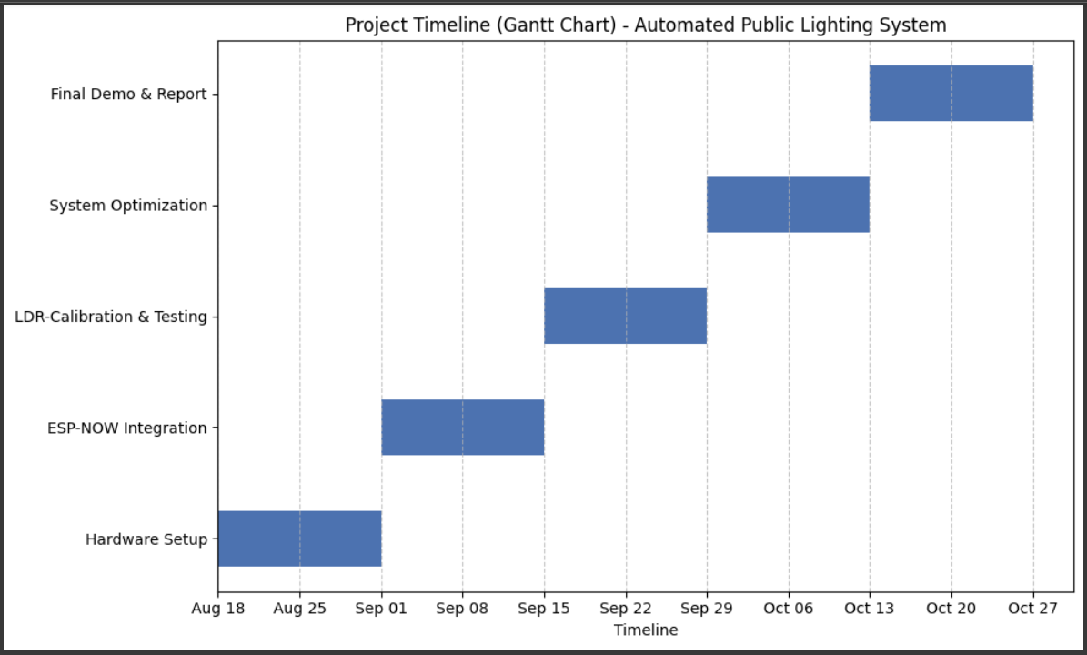
Timeline (Gantt Chart)

Slide 13
References
1. P. K. Sahoo et al., “IoT-Based Smart Lighting System for Energy Efficiency,” IEEE Access, vol. 9, pp. 112158–112173, 2021.
2. Espress if Systems, “ESP-NOW Protocol Documentation,” 2023. [Online]. Available: https://docs.espressif.com/projects/esp-idf/en/latest/esp32/api-reference/network/esp_now.html
3. A. Gupta, “Low-Cost Automation Using ESP8266,” Journal of Embedded Systems, vol. 7, no. 4, pp. 45–59, Dec. 2022.
4. https://www.mdpi.com/2673-4591/56/1/147
5. https://www.mdpi.com/2076-3417/9/16/3281

